Slide 1
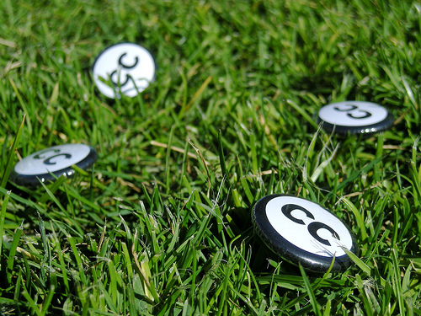



Creative Commons for educators
Jessica Coates
Creative Commons Clinic
April 2008
Carpeted commons by Glutnix, http://www.flickr.com/photos/glutnix/2079709803/in/pool-ccswagcontest07 available under a Creative Commons Attribution 2.0 licence, http://creativecommons.org/licenses/by/2.0/deed.en
AUSTRALIA
part of the Creative Commons international initiative
CRICOS No. 00213J

Slide 2
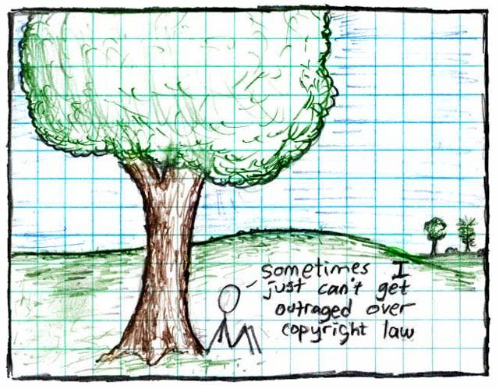

Copyright by xkcd available at http://xkcd.com/14/ under a Creative Commons Attribution NonCommercial 2.5 licence
<http://creativecommons.org/licenses/by-nc/2.5/>
AUSTRALIA
part of the Creative Commons international initiative
CRICOS No. 00213J
Notes:
Some just say ignore copyright law – rip, mix, burn
This is ok if you’re an private user, or an obscure artist – can choose to take risk
But doesn’t work for schools, libraries, museums, charities, academics, short film makers entering into competitions, DJs releasing a commercial CD etc
Plus, the music labels and hollywood are suing people now – and in the UK they’re threatening to cut off people’s internet connections.

Slide 3
Copyright for Educators
Copyright covers everything
Education exceptions:
  Classroom use
  Fair dealing for research and study
  Education statutory licences – Copyright Act Parts VA and VB
  New s200AB open ended exception
AUSTRALIA
part of the Creative Commons international initiative

Slide 4

Aims to make creative material more useable by providing free licences that creators can use to give certain permissions in advance
AUSTRALIA
part of the Creative Commons international initiative
CRICOS No. 00213J

Slide 5

CC is designed to…
provide standardised licences
that facilitate sharing
are flexible
are easy to use and understand (for people and machines) and
that apply in the same way anywhere in the world.
AUSTRALIA
part of the Creative Commons international initiative
CRICOS No. 00213J

Slide 6
CC Myths
CC is not:
Anti-copyright – just another rights management tool for creators
The public domain – just giving certain permission in advance
Anti-commercial – can charge for first use, commercial uses, “premium” service, or embed advertising
Right for every situation – entirely voluntary, and won’t be best solution for all creators
AUSTRALIA
part of the Creative Commons international initiative
CRICOS No. 00213J

Slide 7

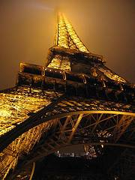
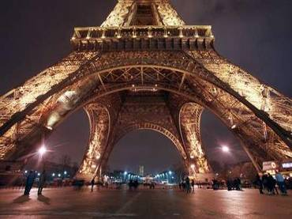
How does it work?
© Sydney Morning Herald
www.smh.com.au
Eiffel Tower at night by rednuht,
http://www.flickr.com/photos/rednuht/275062341/,
AUSTRALIA
part of the Creative Commons international initiative
CRICOS No. 00213J

Slide 8




Licences
4 licence elements:
        Attribution – attribute the author
        Noncommercial – no commercial use
        No Derivative Works – no changes allowed
        ShareAlike – changes allowed, but only if you put the new work under the same licence
AUSTRALIA
part of the Creative Commons international initiative
CRICOS No. 00213J
Notes:
The first CC licences were released in 2002
The central to each of the CC licences are the four licence elements – Attribution, noncommercial, no derivative and sharealike
These represent restrictions that copyright owners may want to put on how people can use their material.
As you can see, each of the elements has a symbol that can be used to ‘represent’ each of these elements
this makes the licences easier understand – in theory, once a person is familiar with the CC licences, they should be able to recognise what uses are allowed simply by looking at the symbols

Slide 9
Attribution
Attribution-ShareAlike
Attribution-Noncommercial
Attribution-Noncommercial-ShareAlike
Attribution-NoDerivatives
Attribution-Noncommercial-NoDerivatives
AUSTRALIA
part of the Creative Commons international initiative
CRICOS No. 00213J
Notes:
Users can mix and match these elements to set the conditions of use for their material
So, for example, an author may be happy to allow private uses of their work, but may want to limit how it can be used commercially.
They may also want people to remix their work, but only so long as that person attributes them and makes the new work available for others to remix
So they can choose the Attribution-noncommercial-sharealike licence

Slide 10
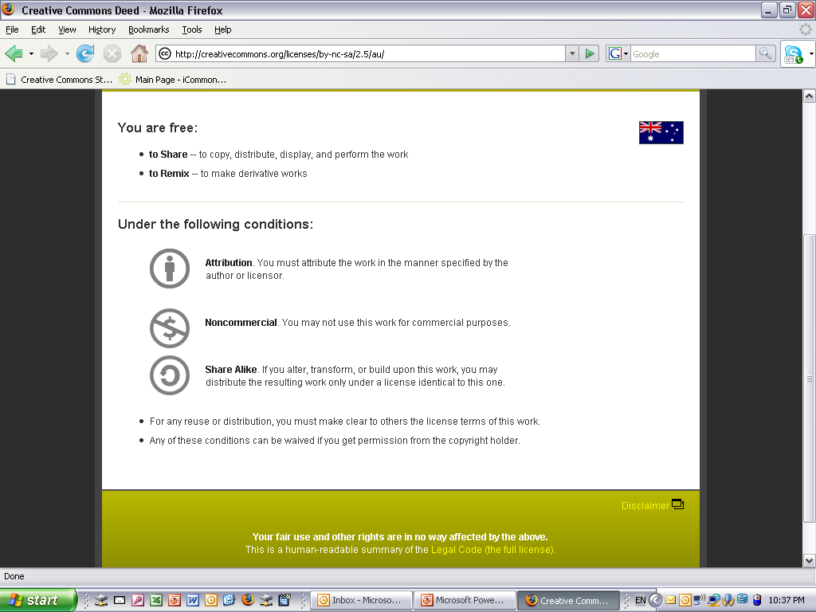
Licences
AUSTRALIA
part of the Creative Commons international initiative
Notes:
. . .to the licence deed, which sets out the licence in plain english terms
You can see the licence element symbols here
By clicking on this link here, you can access . . .

Slide 11
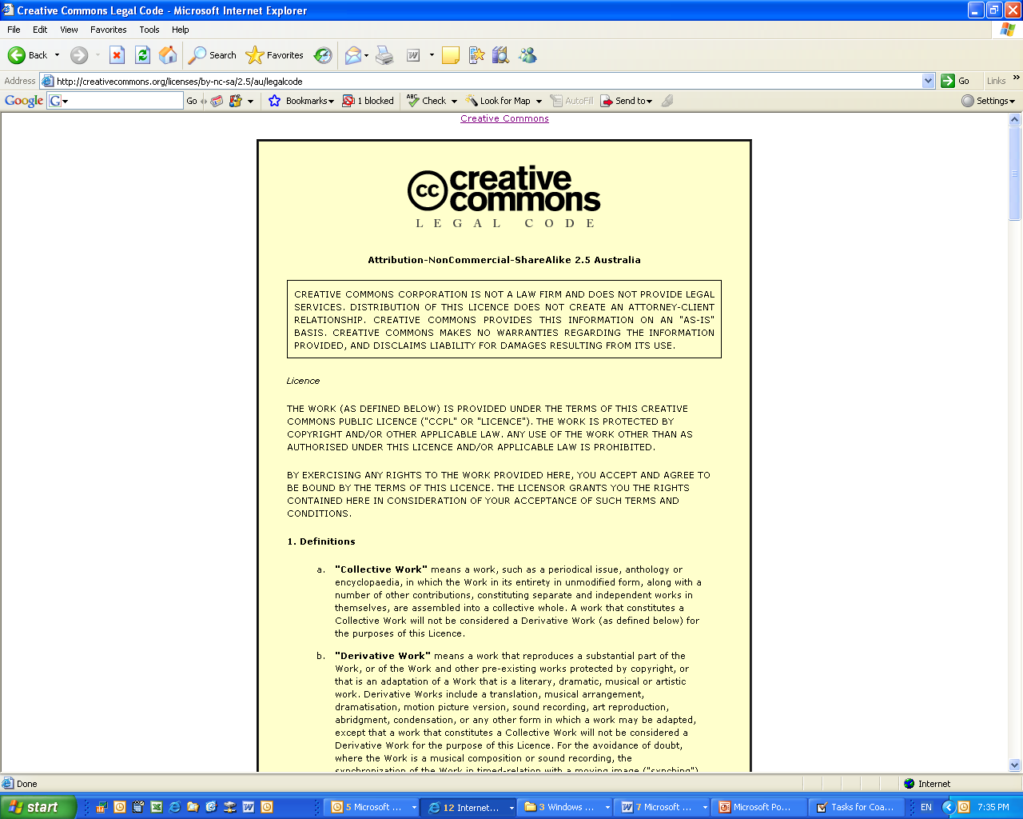
Licences
AUSTRALIA
part of the Creative Commons international initiative
Notes:
The full licence code – which sets out the licence in full legal terms

Slide 12
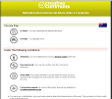
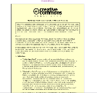
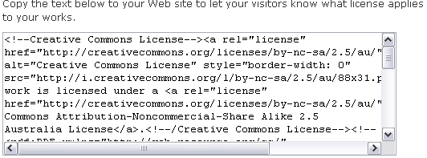
Each licence has
button
deed
metadata
legal code
AUSTRALIA
part of the Creative Commons international initiative
CRICOS No. 00213J

Slide 13
Benefits of CC for Educators
A source of material that can be legally used beyond the limits of Part VB and s200AB
Collaborate and share material your own with other students / teachers / the world
Teach students about what they can do with copyright material (not just what they can’t)
Reduce licence fees under Part VB?
AUSTRALIA
part of the Creative Commons international initiative
CRICOS No. 00213J

Slide 14
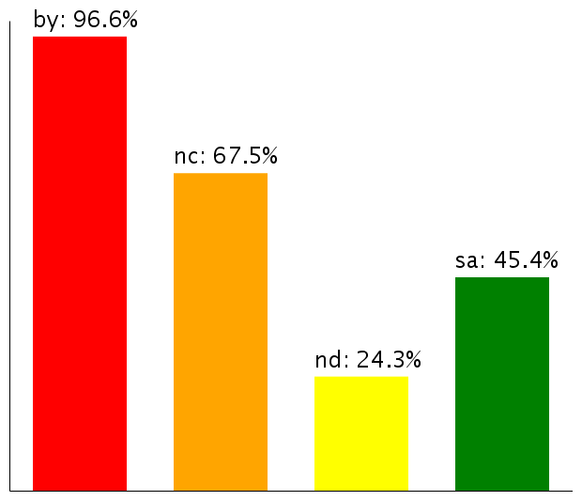
CC as a Resource
About 160 million objects
Over 75 million on Flickr alone
Most have Noncommercial limitation
Moving towards more liberal licences
Use of licence elements – June 2006
AUSTRALIA
part of the Creative Commons international initiative
CRICOS No. 00213J
Notes:
So – looking at how the CC licences are being used
According to the latest statistics from the CC website, there are currently about 140million webpages that use a CC licence
As you can see, almost all of them contain the BY element – that’s because it was made compulsory for all the licences except the public domain licences after the first year, because pretty much everybody was using it anyway
The majority also, unsurprisingly, choose the non-commercial element
Interestingly, next most popular is ShareAlike, not noderivatives – this shows that there is still a strong focus on fostering creativity among CC community, and that, rather than trying to lock their material up, people are happy for it to be remixed, as long as the new work is also sharedEven more interesting is how these statistics are changing over time
Even more interestingly – if you look at how the licences is being used over time, people are gradually moving towards more liberal licences with less restrictions on them
This movement seems to indicate that as people become more familiar with the licences, they are more comfortable allowing greater use
This is supported by anecdotal evidence from CC users who, after initially publishing their material under restrictive licences that don’t allow derivatives, often ‘re-release’ their material to allow new works

Slide 15










Finding CC material
AUSTRALIA
part of the Creative Commons international initiative
CRICOS No. 00213J

Slide 16
Things to think about
Before using CC material:
Check that you’re following the licence (ask for extra permission if necessary)
Do you need any other rights?
Make sure your use isn’t ‘derogatory’
Use common sense
Don’t forget to attribute
AUSTRALIA
part of the Creative Commons international initiative
CRICOS No. 00213J

Slide 17

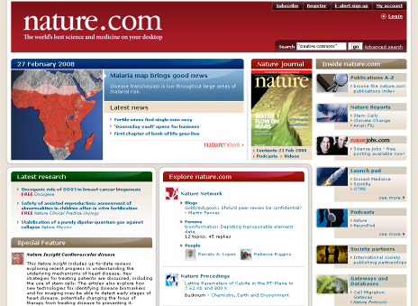


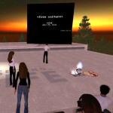
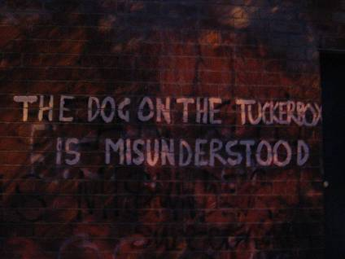

CC as Tool
By Ford Motor company
http://www.flickr.com/photos/fordmotorcompany/2267225172/
Facilitate collaboration
Increase reach and reputation
Don’t reinvent the wheel
Community building
Access new business models
Give new value to ‘back catalogue’
Reduce costs for users
Legal clarity and reduced admin
Increase sum of human knowledge
Encourage innovation
AUSTRALIA
part of the Creative Commons international initiative
CRICOS No. 00213J

Slide 18


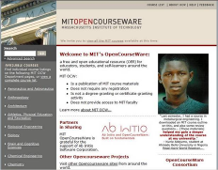

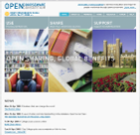
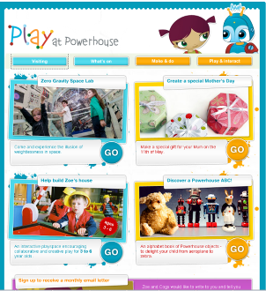
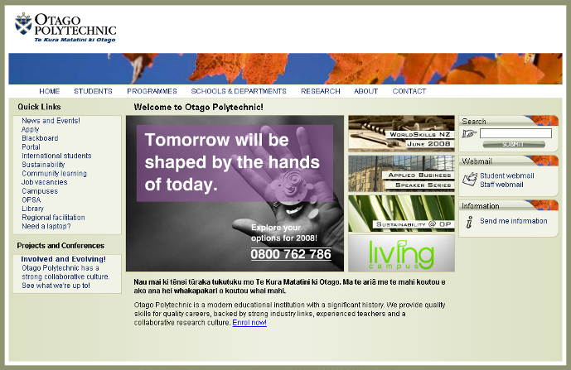



Open Education Resources
http://www.oercommons.org/
http://www.oecd.org/department/
0,3355,en_2649_35845581
_1_1_1_1_1,00.html
https://www.det.nsw.edu.au/tc/neals
http://ocw.mit.edu
www.thelearningfederation.edu.au/
www.ocwconsortium.org/
http://play.powerhousemuseum.com/
www.tekotago.ac.nz/
http://lorn.flexiblelearning.net.au/
http://opentraining.unesco-ci.org
http://www.aesharenet.com.au/
AUSTRALIA
part of the Creative Commons international initiative
CRICOS No. 00213J

Slide 19
Things to think about
Before using CC licences:
Who do you want to use the material, and when? eg global, perpetual
Are you choosing the right licence? eg do you want them to be able to change your material?
Do you have the rights to license the material? Are you using anyone else’s material?
Policy?
AUSTRALIA
part of the Creative Commons international initiative
CRICOS No. 00213J

Slide 20
Thanks
www.smartcopying.edu.au
creativecommons.org
wiki.creativecommons.org/casestudies
creativecommons.org.au
info@creativecommons.org.au
Carpeted commons by Glutnix, http://www.flickr.com/photos/glutnix/2079709803/in/pool-ccswagcontest07 available under a Creative Commons Attribution 2.0 licence, http://creativecommons.org/licenses/by/2.0/deed.en
This slide show is licensed under a Creative Commons Australia Attribution licence. For more information see http://creativecommons.org/licenses/by/2.5/au/.
AUSTRALIA
part of the Creative Commons international initiative
CRICOS No. 00213J

